Slide 1
Recurrent Neural Networks

Slide 2
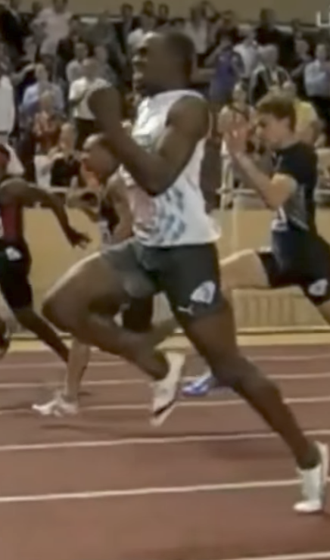
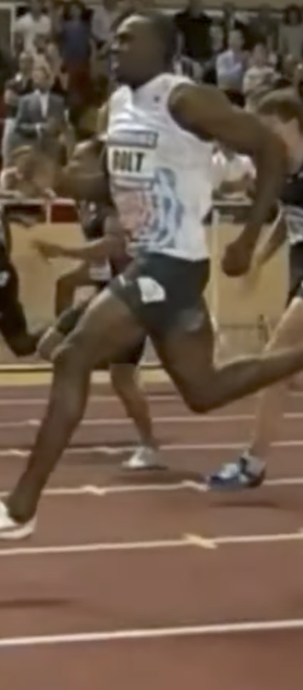
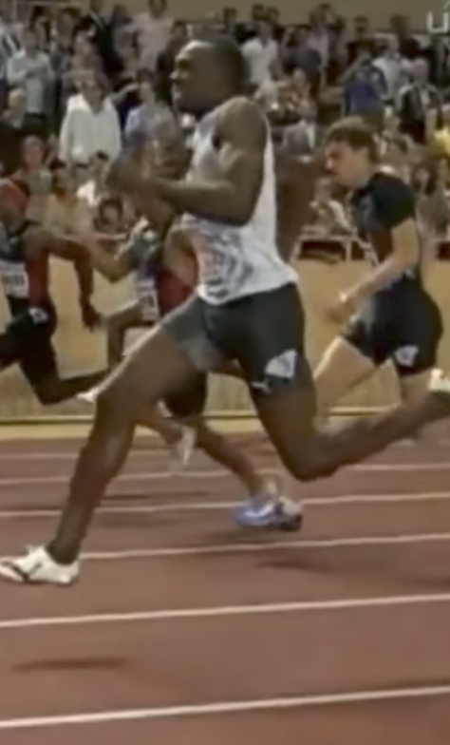
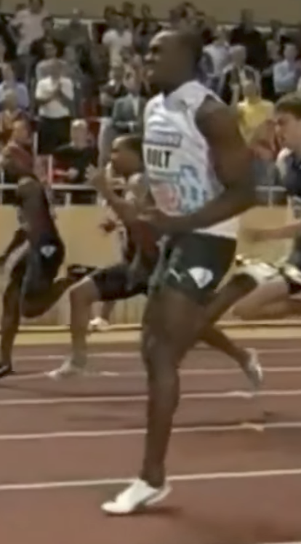
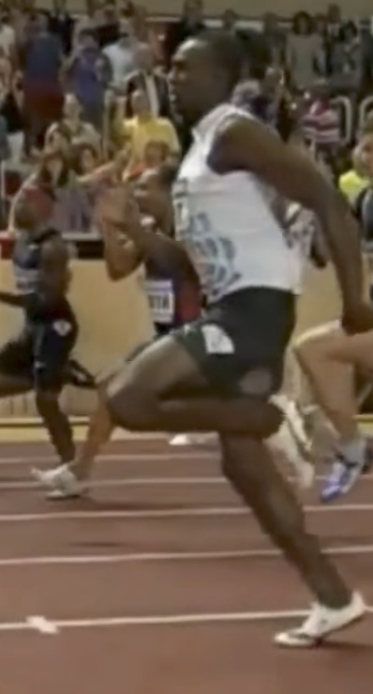

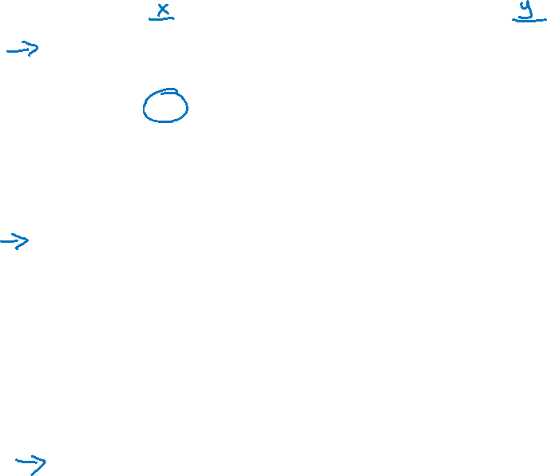
Examples of sequence data
“The quick brown fox jumped over the lazy dog.”
Speech recognition
Music generation
$$∅$$
Sentiment classification
“There is nothing to like in this movie.”
DNA sequence analysis
AGCCCCTGTGAGGAACTAG
AGCCCCTGTGAGGAACTAG
Machine translation
Voulez-vous chanter avec moi?
Do you want to sing with me?
Plasmid sequence AP4 Oligo
Video activity recognition
Running
Name entity recognition
Yesterday, Harry Potter met Hermione Granger.
Yesterday, Harry Potter met Hermione Granger.

Slide 3
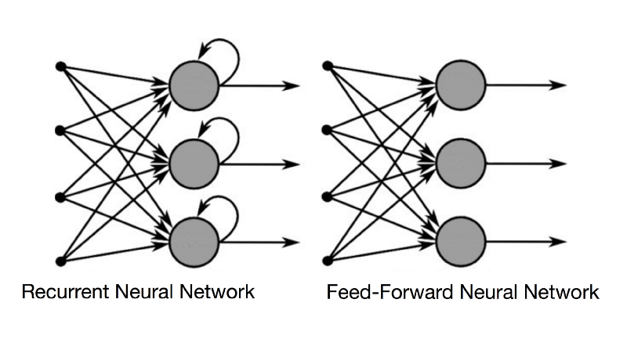
RNN vs FFNN
Source: https://towardsdatascience.com/recurrent-neural-networks-and-lstm-4b601dd822a5

Slide 4
Motivating example
x:
Harry Potter and Hermione Granger invented a new spell.

Slide 5
Representing words
x:
Harry Potter and Hermione Granger invented a new spell.
$$x^{<1>}$$
$$x^{<2>}$$
$$x^{<3>}$$
$$⋯$$
$$x^{<9>}$$

Slide 6
Representing words
x:
Harry Potter and Hermione Granger invented a new spell.
$$x^{<1>}$$
$$x^{<2>}$$
$$x^{<3>}$$
$$⋯$$
$$x^{<9>}$$
And = 367
Invented = 4700
A = 1
New = 5976
Spell = 8376
Harry = 4075
Potter = 6830
Hermione = 4200
Gran… = 4000

Slide 7
Recurrent Neural Networks
He said, “Teddy Roosevelt was a great President.”
He said, “Teddy bears are on sale!”

Slide 8
Forward Propagation
$${\hat{y}}^{<1>}$$
$${\hat{y}}^{<2>}$$
$${\hat{y}}^{<3>}$$
$${\hat{y}}^{<T_{y}>}$$
$$a^{<1>}$$
$$a^{<2>}$$
$$a^{<T_{x}−1>}$$
$$a^{<0>}$$
$$⋯$$
$$x^{<1>}$$
$$x^{<2>}$$
$$x^{<3>}$$
$$x^{<T_{x}>}$$

Slide 9
Simplified RNN notation
$$a^{<t>}=g(W_{aa}a^{<t−1>}+W_{ax}x^{<t>}+b_{a})$$
$${\hat{y}}^{<t>}=g(W_{ya}a^{<t>}+b_{y})$$

Slide 10
Forward propagation and backpropagation
$$ℒ^{<t>}\left({\hat{y}}^{<t>},y^{<t>}\right)=$$
Backpropagation through time

Slide 11
Summary of RNN types
$${\hat{y}}^{<1>}$$
$${\hat{y}}^{<1>}$$
$${\hat{y}}^{<2>}$$
$${\hat{y}}^{<T_{y}>}$$
$${\hat{y}}^{ }$$
$$a^{<0>}$$
$$a^{<0>}$$
$$⋯$$
$$a^{<0>}$$
$$⋯$$
$$x^{<1>}$$
$$x$$
$$x^{<1>}$$
$$x^{<2>}$$
$$x^{<T_{x}>}$$
One to one
One to many
Many to one
$${\hat{y}}^{<1> }$$
$${\hat{y}}^{<2> }$$
$${{\hat{y}}^{<1>}}^{ }$$
$${{\hat{y}}^{<T_{y}>}}^{ }$$
$${\hat{y}}^{<T_{y}> }$$
$$a^{<0>}$$
$$⋯$$
$$⋯$$
$$⋯$$
$$a^{<0>}$$
$$⋯$$
$$x^{<1>}$$
$$x^{<T_{x}>}$$
$$x^{<1>}$$
$$x^{<2>}$$
$$x^{<T_{x}>}$$
Many to many
Many to many

Slide 12
What are language models?

Slide 13
What are language models?
Language models are the ones which assign probability to sentences. They are like functions which take sentence as an input and output its probability.

Slide 14
What are language models?
Language models are the ones which assign probability to sentences. They are like functions which take sentence as an input and output its probability.
So, let us say s1 is some sentence which is a sequence of words (w1, w2, w3), then the language model computes P(s1) = P(w1, w2, w3)

Slide 15
What are language models?
Language models are the ones which assign probability to sentences. They are like functions which take sentence as an input and output its probability.
So, let us say s1 is some sentence which is a sequence of words (w1, w2, w3), then the language model computes P(s1) = P(w1, w2, w3)
It is important to understand that if this probability P(s1) is learnt on a text corpus of Wikipedia (context Wikipedia) than it is meaningful for this context only. For, same s1 and P(s1), it does not remain meaningful for another context like news article corpus. As, model was trained on Wikipedia texts.

Slide 16
What are language models?
Language models are the ones which assign probability to sentences. They are like functions which take sentence as an input and output its probability.
So, let us say s1 is some sentence which is a sequence of words (w1, w2, w3), then the language model computes P(s1) = P(w1, w2, w3)
It is important to understand that if this probability P(s1) is learnt on a text corpus of Wikipedia (context Wikipedia) than it is meaningful for this context only. For, same s1 and P(s1), it does not remain meaningful for another context like news article corpus. As, model was trained on Wikipedia texts.
Any language model does it like P(s1) = P(w1, w2, w3) = P(w1)*P(w2|w1)*P(w3|w1,w2)
In, Statistical Language Model,
P(w1) = count(w1)/sum(count(wi)), where, i = 1, 2, …, n where n is the number of distinct words in text corpus/training set.

Slide 17
What are language models?
Language models are the ones which assign probability to sentences. They are like functions which take sentence as an input and output its probability.
So, let us say s1 is some sentence which is a sequence of words (w1, w2, w3), then the language model computes P(s1) = P(w1, w2, w3)
It is important to understand that if this probability P(s1) is learnt on a text corpus of Wikipedia (context Wikipedia) than it is meaningful for this context only. For, same s1 and P(s1), it does not remain meaningful for another context like news article corpus. As, model was trained on Wikipedia texts.
Any language model does it like P(s1) = P(w1, w2, w3) = P(w1)*P(w2|w1)*P(w3|w1,w2)
In, Statistical Language Model,
P(w1) = count(w1)/sum(count(wi)), where, i = 1, 2, …, n where n is the number of distinct words in text corpus/training set.
P(w2|w1) = count(w1 w2)/count(w1)

Slide 18
What are language models?
Language models are the ones which assign probability to sentences. They are like functions which take sentence as an input and output its probability.
So, let us say s1 is some sentence which is a sequence of words (w1, w2, w3), then the language model computes P(s1) = P(w1, w2, w3)
It is important to understand that if this probability P(s1) is learnt on a text corpus of Wikipedia (context Wikipedia) than it is meaningful for this context only. For, same s1 and P(s1), it does not remain meaningful for another context like news article corpus. As, model was trained on Wikipedia texts.
Any language model does it like P(s1) = P(w1, w2, w3) = P(w1)*P(w2|w1)*P(w3|w1,w2)
In, Statistical Language Model,
P(w1) = count(w1)/sum(count(wi)), where, i = 1, 2, …, n where n is the number of distinct words in text corpus/training set.
P(w2|w1) = count(w1 w2)/count(w1)
P(w3|w1,w2) = count(w1 w2 w3)/count(w1 w2)

Slide 19
What are language models?
Language models are the ones which assign probability to sentences. They are like functions which take sentence as an input and output its probability.
So, let us say s1 is some sentence which is a sequence of words (w1, w2, w3), then the language model computes P(s1) = P(w1, w2, w3)
It is important to understand that if this probability P(s1) is learnt on a text corpus of Wikipedia (context Wikipedia) than it is meaningful for this context only. For, same s1 and P(s1), it does not remain meaningful for another context like news article corpus. As, model was trained on Wikipedia texts.
Any language model does it like P(s1) = P(w1, w2, w3) = P(w1)*P(w2|w1)*P(w3|w1,w2)
In, Statistical Language Model,
P(w1) = count(w1)/sum(count(wi)), where, i = 1, 2, …, n where n is the number of distinct words in text corpus/training set.
P(w2|w1) = count(w1 w2)/count(w1)
P(w3|w1,w2) = count(w1 w2 w3)/count(w1 w2)
There are problems with SLM like big data, noisy data, sparse data, computational efficiency etc…

Slide 20
What are language models?
NNLM:
You need to learn a NN which takes nothing as an input (i.e., one hot vector with all 0) and predict the next word to handle P(w1) (10K neurons in i/p and 10K in o/p)

Slide 21
What are language models?
NNLM:
You need to learn a NN which takes nothing as an input (i.e., one hot vector with all 0) and predict the next word to handle P(w1) (10K neurons in i/p and 10K in o/p)
To handle P(w2|w1), you need to learn one more NN (20K neurons in i/p and 10K in o/p).

Slide 22
What are language models?
NNLM:
You need to learn a NN which takes nothing as an input (i.e., one hot vector with all 0) and predict the next word to handle P(w1) (10K neurons in i/p and 10K in o/p)
To handle P(w2|w1), you need to learn one more NN (20K neurons in i/p and 10K in o/p).
To handle P(w2|w1, w2), you need to learn yet another NN (30K neurons in i/p and 10K in o/p)

Slide 23
What are language models?
NNLM:
You need to learn a NN which takes nothing as an input (i.e., one hot vector with all 0) and predict the next word to handle P(w1) (10K neurons in i/p and 10K in o/p)
To handle P(w2|w1), you need to learn one more NN (20K neurons in i/p and 10K in o/p).
To handle P(w2|w1, w2), you need to learn yet another NN (30K neurons in i/p and 10K in o/p).
Sentences can have any length and we can’t keep on learning NN to handle arbitrarily large sentences and therefore we need RNN.

Slide 24
What are language models?
Applications:
Speech Recognition (as explained on the next slide)
Sentence Generation (As, RNN can predict most probable first word, most probable second word given the first word …..)

Slide 25
What is language modelling?
Applications:
Speech recognition & Text Generation
The apple and pair salad.
The apple and pear salad.
$P($The apple and pair salad$)=$
$P($The apple and pear salad$)=$

Slide 26
Language modelling with an RNN
Training set: large corpus of english text.
Cats average 15 hours of sleep a day.
The Egyptian Mau is a breed of cat. <EOS>

Slide 27
RNN model
Cats average 15 hours of sleep a day. <EOS>
$$ℒ\left({\hat{y}}^{<t>},y^{<t>}\right)=−\sum_{i}{ }y_{i}^{<t>}{\log{\hat{y}}}_{i}^{<t>}$$
$$ℒ^{ }=\sum_{t}{ }ℒ^{<t>}\left({\hat{y}}^{<t>},y^{<t>}\right)$$

Slide 28
Sampling a sequence from a trained RNN
$${\hat{y}}^{<1> }$$
$${\hat{y}}^{<2> }$$
$${\hat{y}}^{<3> }$$
$${\hat{y}}^{<T_{y}> }$$
$$a^{<0>}$$
$$a^{<1>}$$
$$a^{<2>}$$
$$a^{<3>}$$
$$⋯$$
$$a^{<T_{y}>}$$
$$x^{<1>}$$
$$y^{<1>}$$
$$y^{<2>}$$
$$y^{<T_{x}−1>}$$
numpy.random.choice(a, size=None, replace=True, p=None)

Slide 29
Character-level language model
Vocabulary = [a, aaron, …, zulu, <UNK>]
$${\hat{y}}^{<1> }$$
$${\hat{y}}^{<2> }$$
$${\hat{y}}^{<3> }$$
$${\hat{y}}^{<T_{y}> }$$
$$a^{<0>}$$
$$a^{<1>}$$
$$a^{<2>}$$
$$a^{<3>}$$
$$⋯$$
$$a^{<T_{y}>}$$
$$x^{<1>}$$
$${\hat{y}}^{<1> }$$
$${\hat{y}}^{<2> }$$
$${\hat{y}}^{<T_{x}−1> }$$

Slide 30
Sequence generation
News
Shakespeare
President enrique peña nieto, announced sench’s sulk former coming football langston paring.
“I was not at all surprised,” said hich langston.
“Concussion epidemic”, to be examined.
The gray football the told some and this has on the uefa icon, should money as.
The mortal moon hath her eclipse in love.
And subject of this thou art another this fold.
When besser be my love to me see sabl’s.
For whose are ruse of mine eyes heaves.

Slide 31
Vanishing gradients with RNNs
$${\hat{y}}^{<1> }$$
$${\hat{y}}^{<2> }$$
$${\hat{y}}^{<3> }$$
$${\hat{y}}^{<T_{y}> }$$
$$a^{<0>}$$
$$a^{<1>}$$
$$a^{<2>}$$
$$a^{<3>}$$
$$⋯$$
$$a^{<T_{y}>}$$
$$x^{<1>}$$
$$x^{<2>}$$
$$x^{<3>}$$
$$x^{<T_{x}>}$$
$$x^{ }$$
$$⋯$$
$${\hat{y}}^{ }$$
$$⋮$$
$$⋮$$
$$⋮$$
$$⋮$$
$$⋮$$
$$⋮$$
$$⋮$$
Exploding gradients.

Slide 32
RNN unit
$$a^{<t>}=g(W_{a}\left[a^{<t−1>}, x^{<t>}\right]+b_{a})$$
$${\hat{y}}^{<1> }$$
$$a^{<0>}$$
$$a^{<1>}$$
$$x^{<1>}$$

Slide 33
GRU (simplified)
The cat, which already ate …, was full.
[Cho et al., 2014. On the properties of neural machine translation: Encoder-decoder approaches]
[Chung et al., 2014. Empirical Evaluation of Gated Recurrent Neural Networks on Sequence Modeling]

Slide 34
Full GRU
$${\tilde{c}}^{<t>}=\tanh{(W_{c}[}$$
$$c^{<t−1>},x^{<t>}]+b_{c})$$
$$Γ_{u}=σ{(W_{u}\left[ c^{<t−1>},x^{<t>}\right]+b_{u})}$$
$$c^{<t>}=Γ_{u}{∗{\tilde{c}}^{<t>}+\left(1−Γ_{u}\right)+c^{<t−1>}}$$
The cat, which ate already, was full.

Slide 35
LSTM units
GRU
LSTM
$${\tilde{c}}^{<t>}=\tanh{(W_{c}\left[Γ_{r}∗c^{<t−1>},x^{<t>}\right]+b_{c})}$$
$${\tilde{c}}^{<t>}=\tanh{(W_{c}\left[a^{<t−1>},x^{<t>}\right]+b_{c})}$$
$$Γ_{u}=σ{(W_{u}\left[ c^{<t−1>},x^{<t>}\right]+b_{u})}$$
$$Γ_{u}=σ{(W_{u}\left[ a^{<t−1>},x^{<t>}\right]+b_{u})}$$
$$Γ_{r}=σ{(W_{r}\left[ c^{<t−1>},x^{<t>}\right]+b_{r})}$$
$$Γ_{f}=σ{(W_{f}\left[ a^{<t−1>},x^{<t>}\right]+b_{f})}$$
$$c^{<t>}=Γ_{u}{∗{\tilde{c}}^{<t>}+\left(1−Γ_{u}\right)∗c^{<t−1>}}$$
$$Γ_{o}=σ{(W_{o}\left[ a^{<t−1>},x^{<t>}\right]+b_{o})}$$
$$a^{<t>}=c^{<t>}$$
$$c^{<t>}={Γ_{u}∗{\tilde{c}}^{<t>}+Γ_{f}∗c^{<t−1>}}$$
$$a^{<t>}=Γ_{o}∗c^{<t>}$$
[Hochreiter & Schmidhuber 1997. Long short-term memory]

Slide 36
LSTM in pictures
$$y^{<t>}$$
$${\tilde{c}}^{<t>}=\tanh{(W_{c}\left[a^{<t−1>},x^{<t>}\right]+b_{c})}$$
softmax
$$a^{<t>}$$
$$Γ_{u}=σ{(W_{u}\left[ a^{<t−1>},x^{<t>}\right]+b_{u})}$$
-
-
$$c^{<t−1>}$$
$$c^{<t>}$$
-
*
$$⨁$$
-
$$Γ_{f}=σ{(W_{f}\left[ a^{<t−1>},x^{<t>}\right]+b_{f})}$$
$$c^{<t>}$$
*
tanh
$$Γ_{o}=σ{(W_{o}\left[ a^{<t−1>},x^{<t>}\right]+b_{o})}$$
$$a^{<t−1>}$$
*
$$a^{<t>}$$
$$f^{<t>}$$
$$i^{<t>}$$
$${\tilde{c}}^{<t>}$$
$$o^{<t>}$$
$$a^{<t>}$$
$$c^{<t>}={Γ_{u}∗{\tilde{c}}^{<t>}+Γ_{f}∗c^{<t−1>}}$$
forget gate
update gate
tanh
output gate
$$a^{<t>}=Γ_{o}∗c^{<t>}$$
$$x^{<t>}$$
$$y^{<1>}$$
$$y^{<2>}$$
$$y^{<3>}$$
softmax
softmax
softmax
$$a^{<1>}$$
$$a^{<2>}$$
-
$$c^{<2>}$$
$$a^{<3>}$$
-
-
$$c^{<1>}$$
-
-
$$c^{<3>}$$
-
-
-
-
-
-
$$c^{<0>}$$
*
$$⨁$$
-
$$c^{<1>}$$
*
$$⨁$$
$$c^{<2>}$$
*
$$⨁$$
$$a^{<0>}$$
$$a^{<1>}$$
$$a^{<2>}$$
$$a^{<2>}$$
$$a^{<1>}$$
$$a^{<3>}$$
$$x^{<1>}$$
$$x^{<2>}$$
$$x^{<3>}$$

Slide 37
Getting information from the future
He said, “Teddy bears are on sale!”
He said, “Teddy Roosevelt was a great President!”
$${\hat{y}}^{<1> }$$
$${\hat{y}}^{<2> }$$
$${\hat{y}}^{<3> }$$
$${\hat{y}}^{<4> }$$
$${\hat{y}}^{<5> }$$
$${\hat{y}}^{<6> }$$
$${\hat{y}}^{<7> }$$
$$a^{<0>}$$
$$a^{<1>}$$
$$a^{<2>}$$
$$a^{<3>}$$
$$a^{<4>}$$
$$a^{<5>}$$
$$a^{<6>}$$
$$a^{<7>}$$
$$x^{<1>}$$
$$x^{<2>}$$
$$x^{<3>}$$
$$x^{<4>}$$
$$x^{<5>}$$
$$x^{<6>}$$
$$x^{<7>}$$
He said, “Teddy bears are on sale!”

Slide 38
Bidirectional RNN (BRNN)

Slide 39
Bidirectional RNN (BRNN)

Slide 40
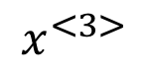
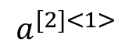
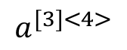
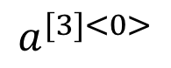
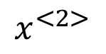
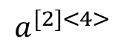
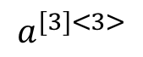
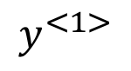
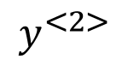
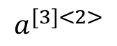
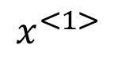
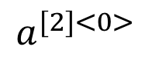
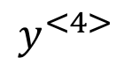
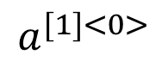
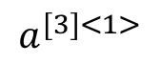
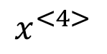
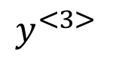
Deep RNN example
$$y^{<1>}$$
$$y^{<2>}$$
$$y^{<3>}$$
$$y^{<4>}$$
$$a^{[3]<0>}$$
$$a^{[3]<1>}$$
$$a^{[3]<2>}$$
$$a^{[3]<3>}$$
$$a^{[3]<4>}$$
$$a^{[2]<0>}$$
$$a^{[2]<1>}$$
$$a^{[2]<2>}$$
$$a^{[2]<3>}$$
$$a^{[2]<4>}$$
$$a^{[1]<0>}$$
$$x^{<1>}$$
$$x^{<2>}$$
$$x^{<3>}$$
$$x^{<4>}$$

Slide 41
References
Andrew Ng’s Course on Sequence Models at deeplearning.ai

Slide 42
Disclaimer
These slides are not original and have been prepared from various sources (Andrew Ng’s Course on Sequence Models at deeplearning.ai) for teaching purpose.

